Slide 1

Customer Churn Prediction
For a Telecom Provider

Slide 2




Why Predict Churn?
Revenue Loss
Retention Efficiency
Churn is a critical driver of revenue loss in subscription businesses.
Identifying high-risk customers for targeted retention campaigns.
Optimize Costs
Acquiring new customers is more expensive than retaining existing ones.

Slide 3
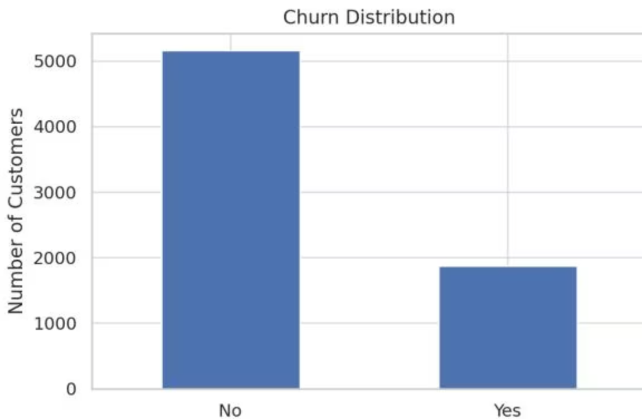
The Telco Churn Dataset
7,043 customer records with 21 variables: demographics, account info, services, billing.
Target variable: Churn ('Yes' or 'No').
Data Cleaning: Converted 'TotalCharges' to numeric, handled missing values.
Result: 7,032 customers, 21 columns for analysis.
Churn Distribution: ~26% churned, ~74% stayed.

Slide 4
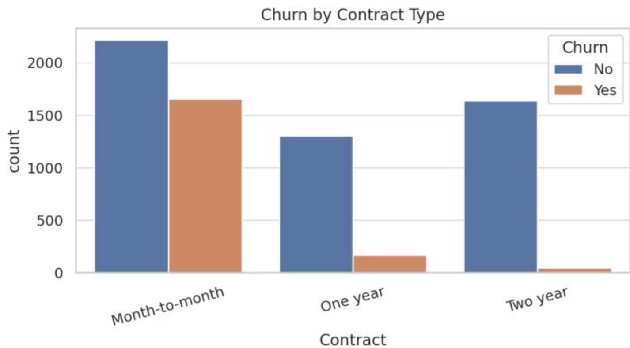
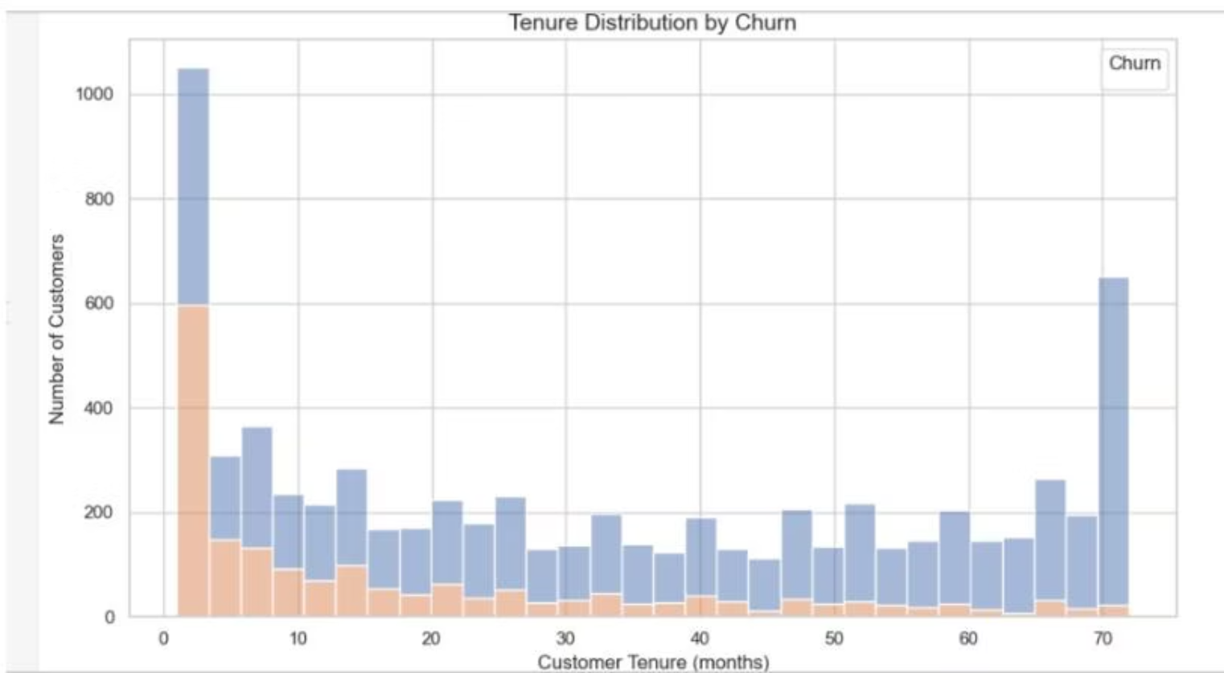
Key Churn Drivers: Contract & Tenure
Contract Type
Customer Tenure
Month-to-month contracts show significantly higher churn.
Churn is concentrated among customers with low tenure.

Slide 5





Modeling Approach
Data Split
80/20 stratified split for training and testing.
Preprocessing
Standardized numeric, one-hot encoded categorical features.
Model Training
Logistic Regression, Random Forest, Gradient Boosting.
Evaluation
Accuracy, Precision, Recall, F1-score, ROC-AUC.

Slide 6
Model Performance Comparison
Gradient Boosting
0.796
0.641
0.529
0.580
0.838
Logistic Regression
0.724
0.488
0.791
0.603
0.834
Random Forest
0.785
0.624
0.484
0.545
0.817
Gradient Boosting achieved highest accuracy and ROC-AUC. Logistic Regression had highest recall.

Slide 7
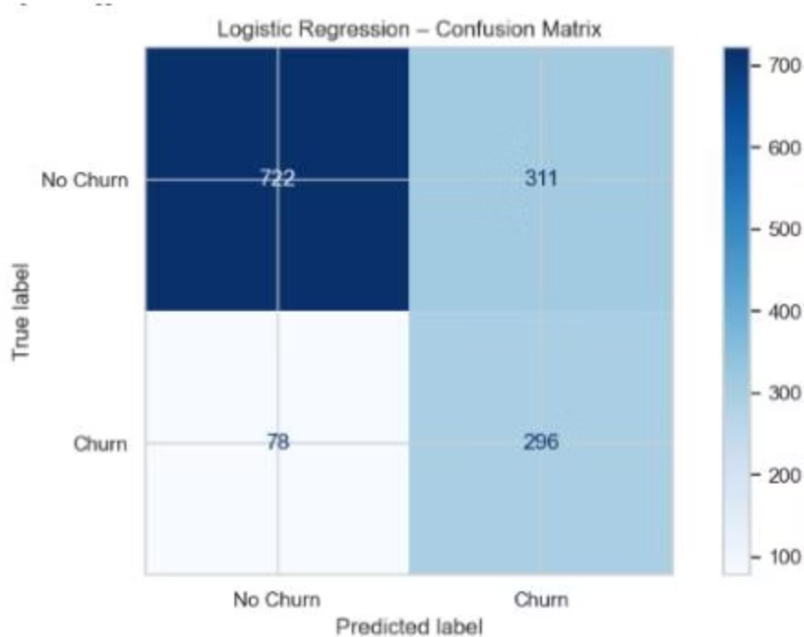
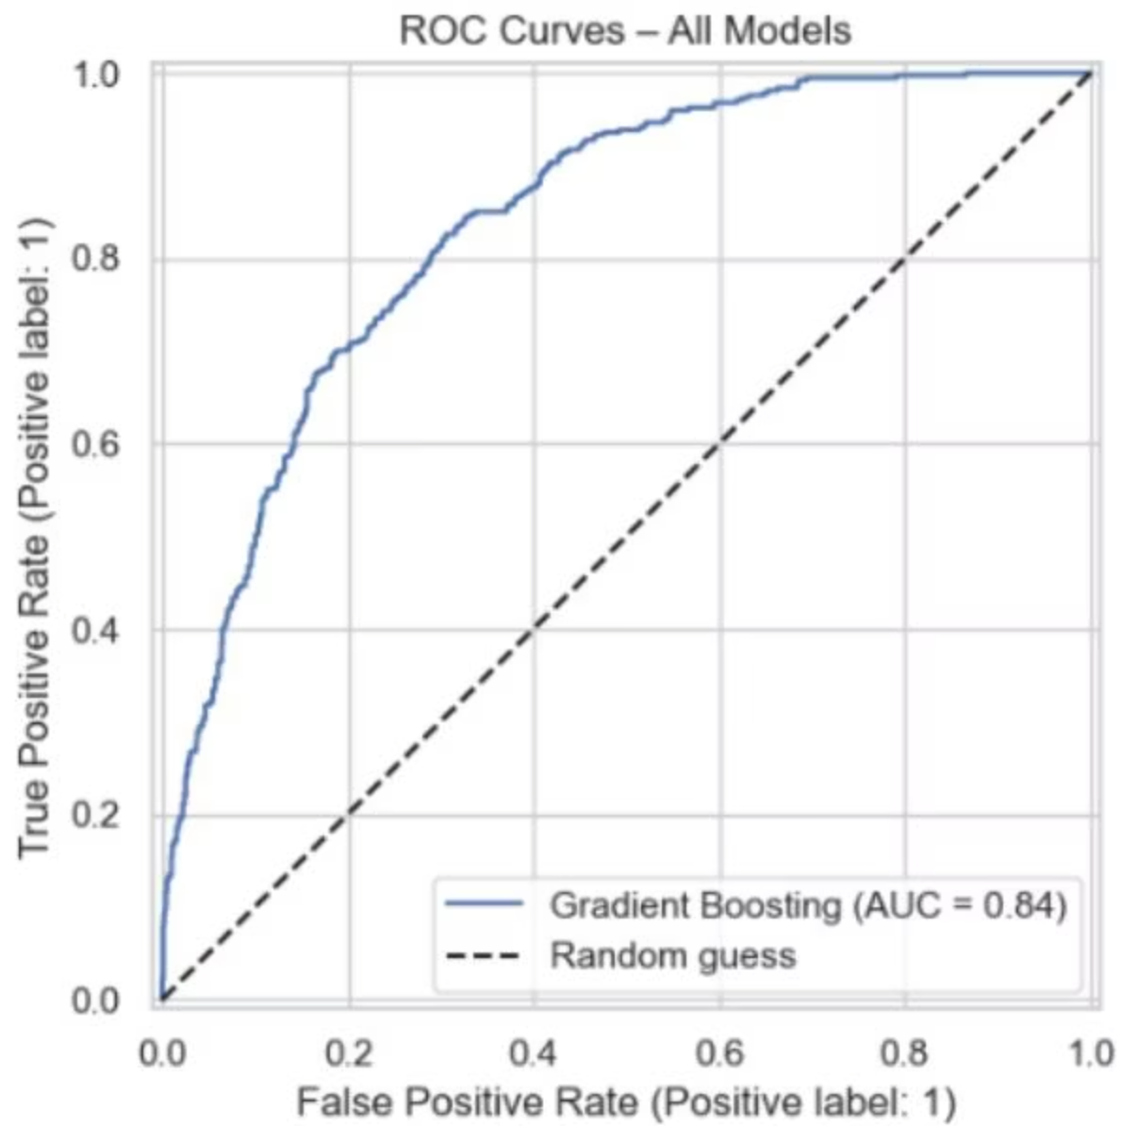
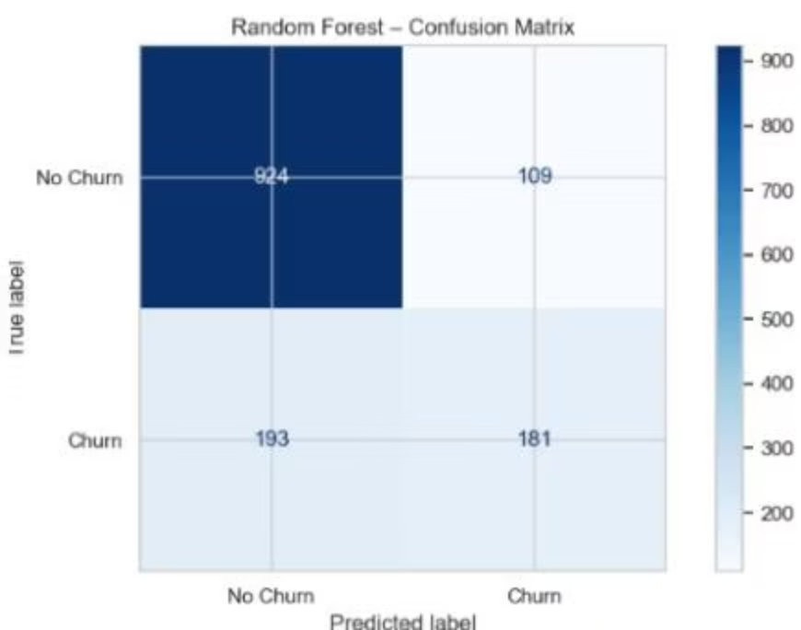
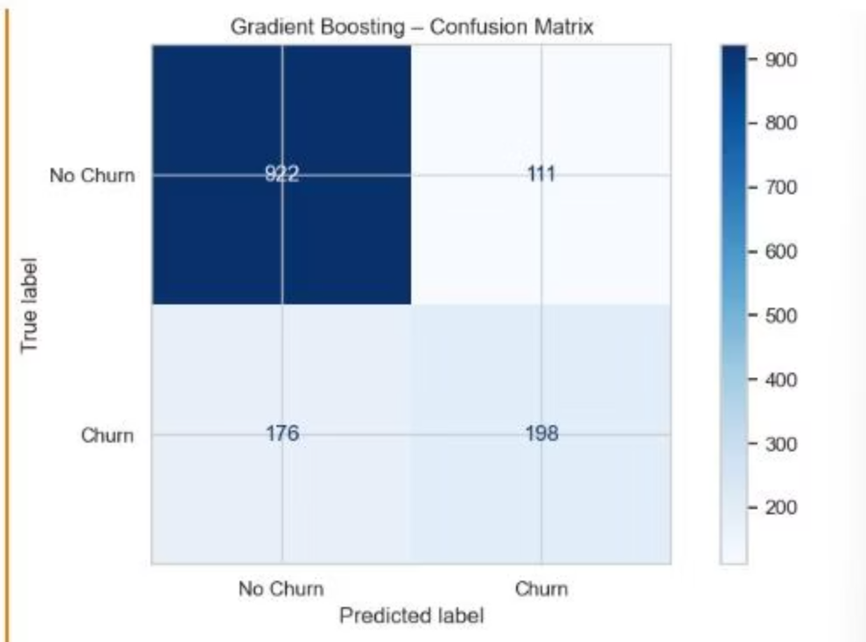
ROC Curves & Confusion Matrices
All models outperform random guessing. Gradient Boosting shows the largest AUC.
Logistic Regression has higher recall (fewer false negatives). Gradient Boosting balances precision and recall.

Slide 8
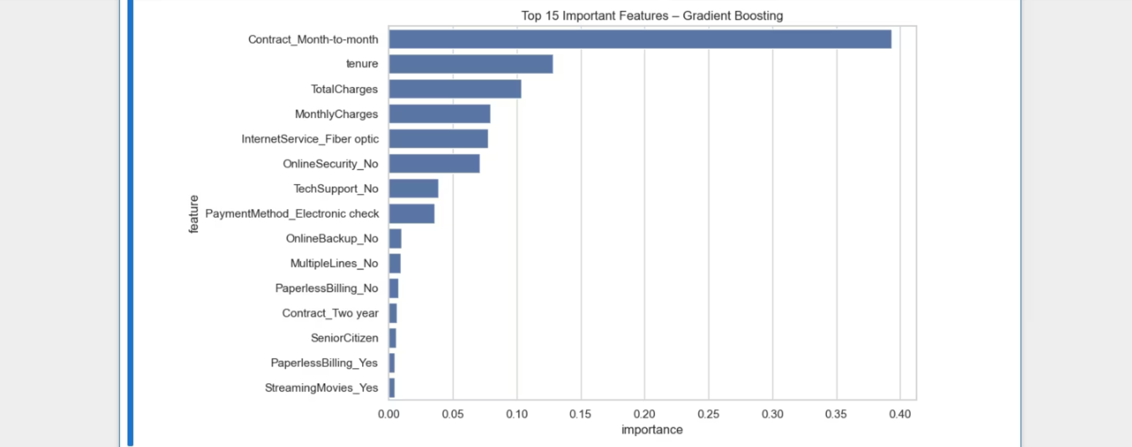

Slide 9
Top Churn Drivers
Gradient Boosting model reveals key factors.
Month-to-month contracts
Tenure & Charges
Strongest risk factor for churn.
Low tenure, low cumulative charges increase churn risk.
Service Gaps
Payment Method
Lack of online security/tech support, fiber optic internet.
Electronic check users more likely to churn.

Slide 10

Actionable Business Recommendations
01
02
Target Month-to-Month
Strengthen Early Engagement
Incentivize migration to longer contracts with discounts or bundles.
Proactive check-ins, welcome offers, and quick issue resolution for new customers.
03
04
Pricing Transparency
Promote Auto-Payments
Review pricing, offer tiered plans, and proactively address bill increases.
Encourage electronic check users to switch to automatic payments.

Slide 11

Conclusion & Future Work
Key Takeaways
Limitations & Next Steps
Gradient Boosting: Best performance (ROC-AUC 0.84).
Historical data, limited features (no satisfaction scores, network quality).
Logistic Regression: Strong, interpretable baseline with high recall.
Future work: Hyperparameter tuning, cost-sensitive modeling, SHAP values for interpretability.
Key churn drivers: Month-to-month contracts, short tenure, high charges, lack of support, electronic check payment.

